Slide 1
ARC Small Business Office
Christine Munroe
ARC Small Business Specialist
April 4, 2018

Slide 2
Agenda
Procurement Center Representative Change
State of Small Business at NASA
Upcoming Agency and Local Outreach events
Small Business Month “May 2018”
Learning Series: Webinar & Podcast and Mentor Protégé Update

Slide 3
Important Points Of Contact at ARC
CONTACT | TITLE | EMAIL | PHONE
Christine Munroe | Small Business Specialist | ARC-SmallBusiness@mail.nasa.gov | 650-604-4695
Carolina Blake | Small Business Technical Advisor | carolina.blake@nasa.gov | 650-604-0893
Aaron Parra | SBA PCR | aaron.parra@sba.gov | 818-552-3297
Carol Carroll | Competition Advocate | carol.w.carroll@nasa.gov | 650-604- 5068
Kelly Kaplan | Procurement Officer | kelly.g.kaplan@nasa.gov | 650-604-5814
Ts
5

Slide 4
State of Small Business at NASA
Glenn A. Delgado
Associate Administrator
March 8, 2018

Slide 5
NASA Agency Small Business Metrics
FY17 Prime Goals vs. Actual Percentages
CATEGORY | DOLLARS
TOTAL DOLLARS | $16,489,553,702
SMALL BUSINESS | $2,720,775,694
SDB | $1,275,401,438
WOSB | $724,853,613
HUBZone | $78,079,903
SDVOSB | $169,109,318
Data generated February 20, 2018 from FPDS-NG

Slide 6
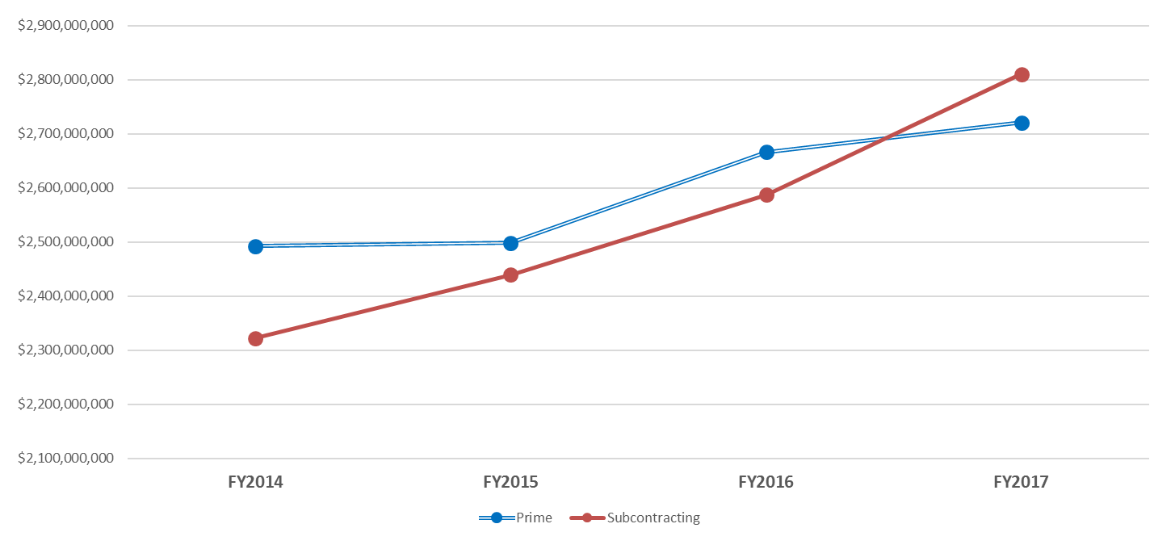
NASA Agency Small Business Metrics
FY14-FY17 Comparison
 | FY2013 | FY2014 | FY2015 | FY2016 | FY2017
Prime | $2,756,640,377 | $2,492,259,589 | $2,498,551,080 | $2,666,446,582 | $2,720,775,694
Subcontracting | $2,319,724,401 | $2,322,525,808 | $2,439,408,283 | $2,587,358,226 | $2,810,378,010
Total SB | $5,076,364,778 | $4,814,785,397 | $4,937,959,363 | $5,253,804,808 | $5,531,153,704
Total Spend | $12,733,636,452 | $13,597,154,582 | $14,417,976,809 | $15,993,717,656 | $16,489,553,702
Prime Data generated February 20, 2018 from FPDS-NG
Subcontracting Data generated February 12, 2018 from eSRS

Slide 7
NASA WOSB Small Business Metrics
FY14-F17 Comparison
 | FY2014 | FY2015 | FY2016 | FY2017
Prime | $448,505,496 | $493,206,056 | $647,981,573 | $724,853,613
Subcontracting | $573,190,967 | $608,048,392 | $704,025,436 | $682,241,050

Slide 8
NASA SDVOSB Small Business Metrics
FY14-F17 Comparison
 | FY2014 | FY2015 | FY2016 | FY2017
Prime | $78,097,211 | $102,953,179 | $137,881,363 | $169,109,318
Subcontracting | $170,540,532 | $201,194,277 | $194,421,895 | $237,143,365

Slide 9
Current Agency and ARC Metrics
As of March 7, 2018

Slide 10
NASA Agency February FY18
Prime Goals vs. Actual Percentages
Data generated March 7, 2018 from FPDS-NG
CATEGORY | DOLLARS
TOTAL DOLLARS | $5,951,221,093
SMALL BUSINESS | $789,425,429
SDB | $330,010,631
WOSB | $273,709,337
HUBZone | $30,045,022
SDVOSB | $57,210,560

Slide 11
ARC February FY18
Prime Goals vs. Actual Percentages
Data generated March 7, 2018 from FPDS-NG
CATEGORY | DOLLARS
TOTAL DOLLARS | $76,548,556
SMALL BUSINESS | $31,701,143
SDB | $17,245,566
WOSB | $2,479,290
HUBZone | $9,709,544
SDVOSB | $2,986,403

Slide 12
Upcoming Outreach Events
r
FY 2018

Slide 13
FY18 Mandatory Events & Meetings

Slide 14
FY18 Socioeconomic
Outreach Events

Slide 15
ARC SBS
April Outreach Event
April 11, 2018 - State Compensation Insurance Fund 4th Annual Supplier Diversity Summit - 9:00 am - 3:00 pm
State Fund’s Learning Center, 1010 Vaquero Circle Vacaville, California 95688
Online Registration: https://scif2018.mybusinessmatches.com/
Questions: SupplierDiversity@scif.com

Slide 16
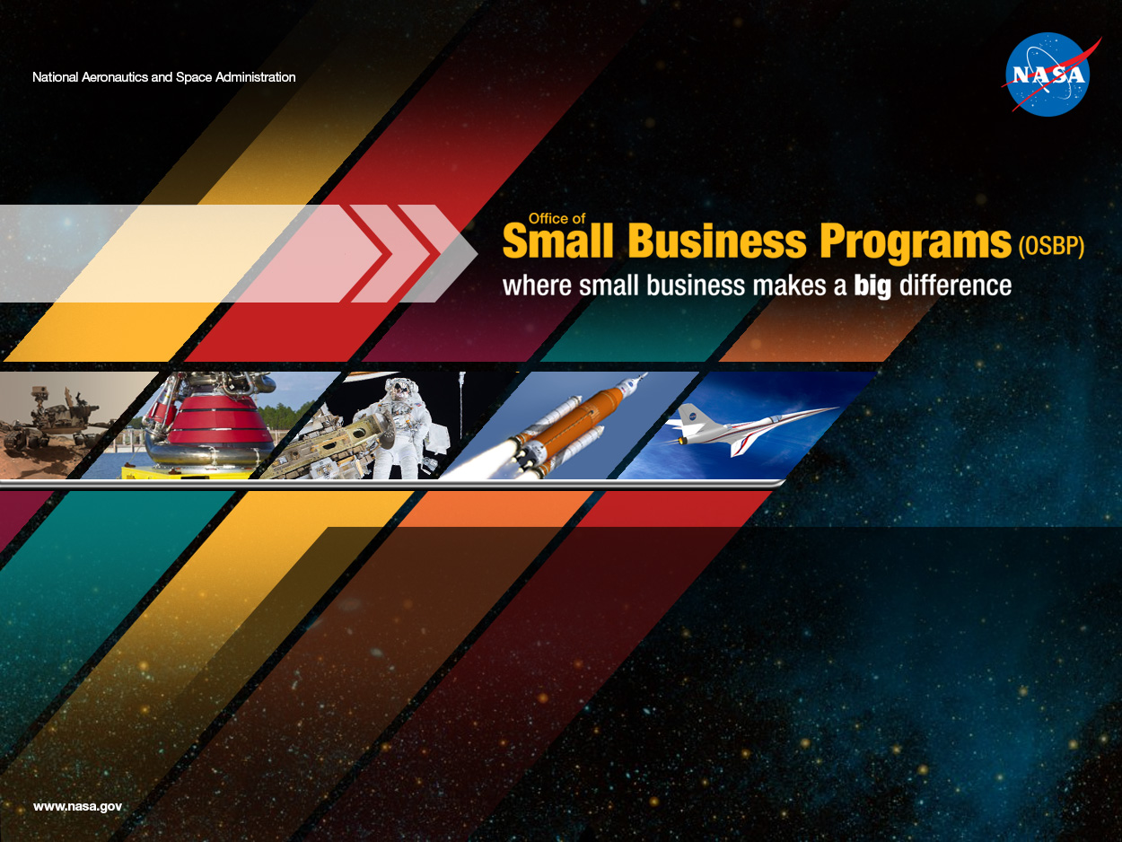
Small Business Month “May 2018”
r

Slide 17
Small Business Month May 2018
NASA will be recognizing WOSB companies at the agency this year 4/29/18 – 5/5/18
Things you can do to participate during Small Business Month
Register or Update your information in NVDB https://osbp.nasa.gov/vendor_database.html
Add the NASA OSBP app to your phone https://osbp.nasa.gov/osbp-mobile.html
Large Business add your subcontract requirements to the NVDB subcontracting module
Review the Mentor Protégé https://osbp.nasa.gov/mpp/index.html
Review the Capability information for HBCU/MI https://osbp.nasa.gov/event-presentations.html
Submit a Success Story for your Company if you are Large or Small to ARC-SmallBusiness@mail.nasa.gov by 4/19/18
Large Business if you are interested in meeting with Small businesses on 5/3/18 please send me an email ARC-SmallBusiness@mail.nasa.gov
Request I’m looking for Tips for prospective Small Business who are interested in doing business with NASA ARC by 4/13/18
Review the ARC Small Business Office Upcoming Events page https://www.nasa.gov/ames/small-business-schedule
Attend the SF Small Business Week event in San Francisco, CA https://www.sfsmallbusinessweek.com/
Attend Oakland Small Business Week http://www2.oaklandnet.com/sbw/index.htm

Slide 18
The Tabi Hour: Learning Series: Webinar & Podcast Mentor-Protégé Program Comparison
Presenter: Tabisa Taliwaku Kalisa
Thursday, March 8, 2018

Slide 19
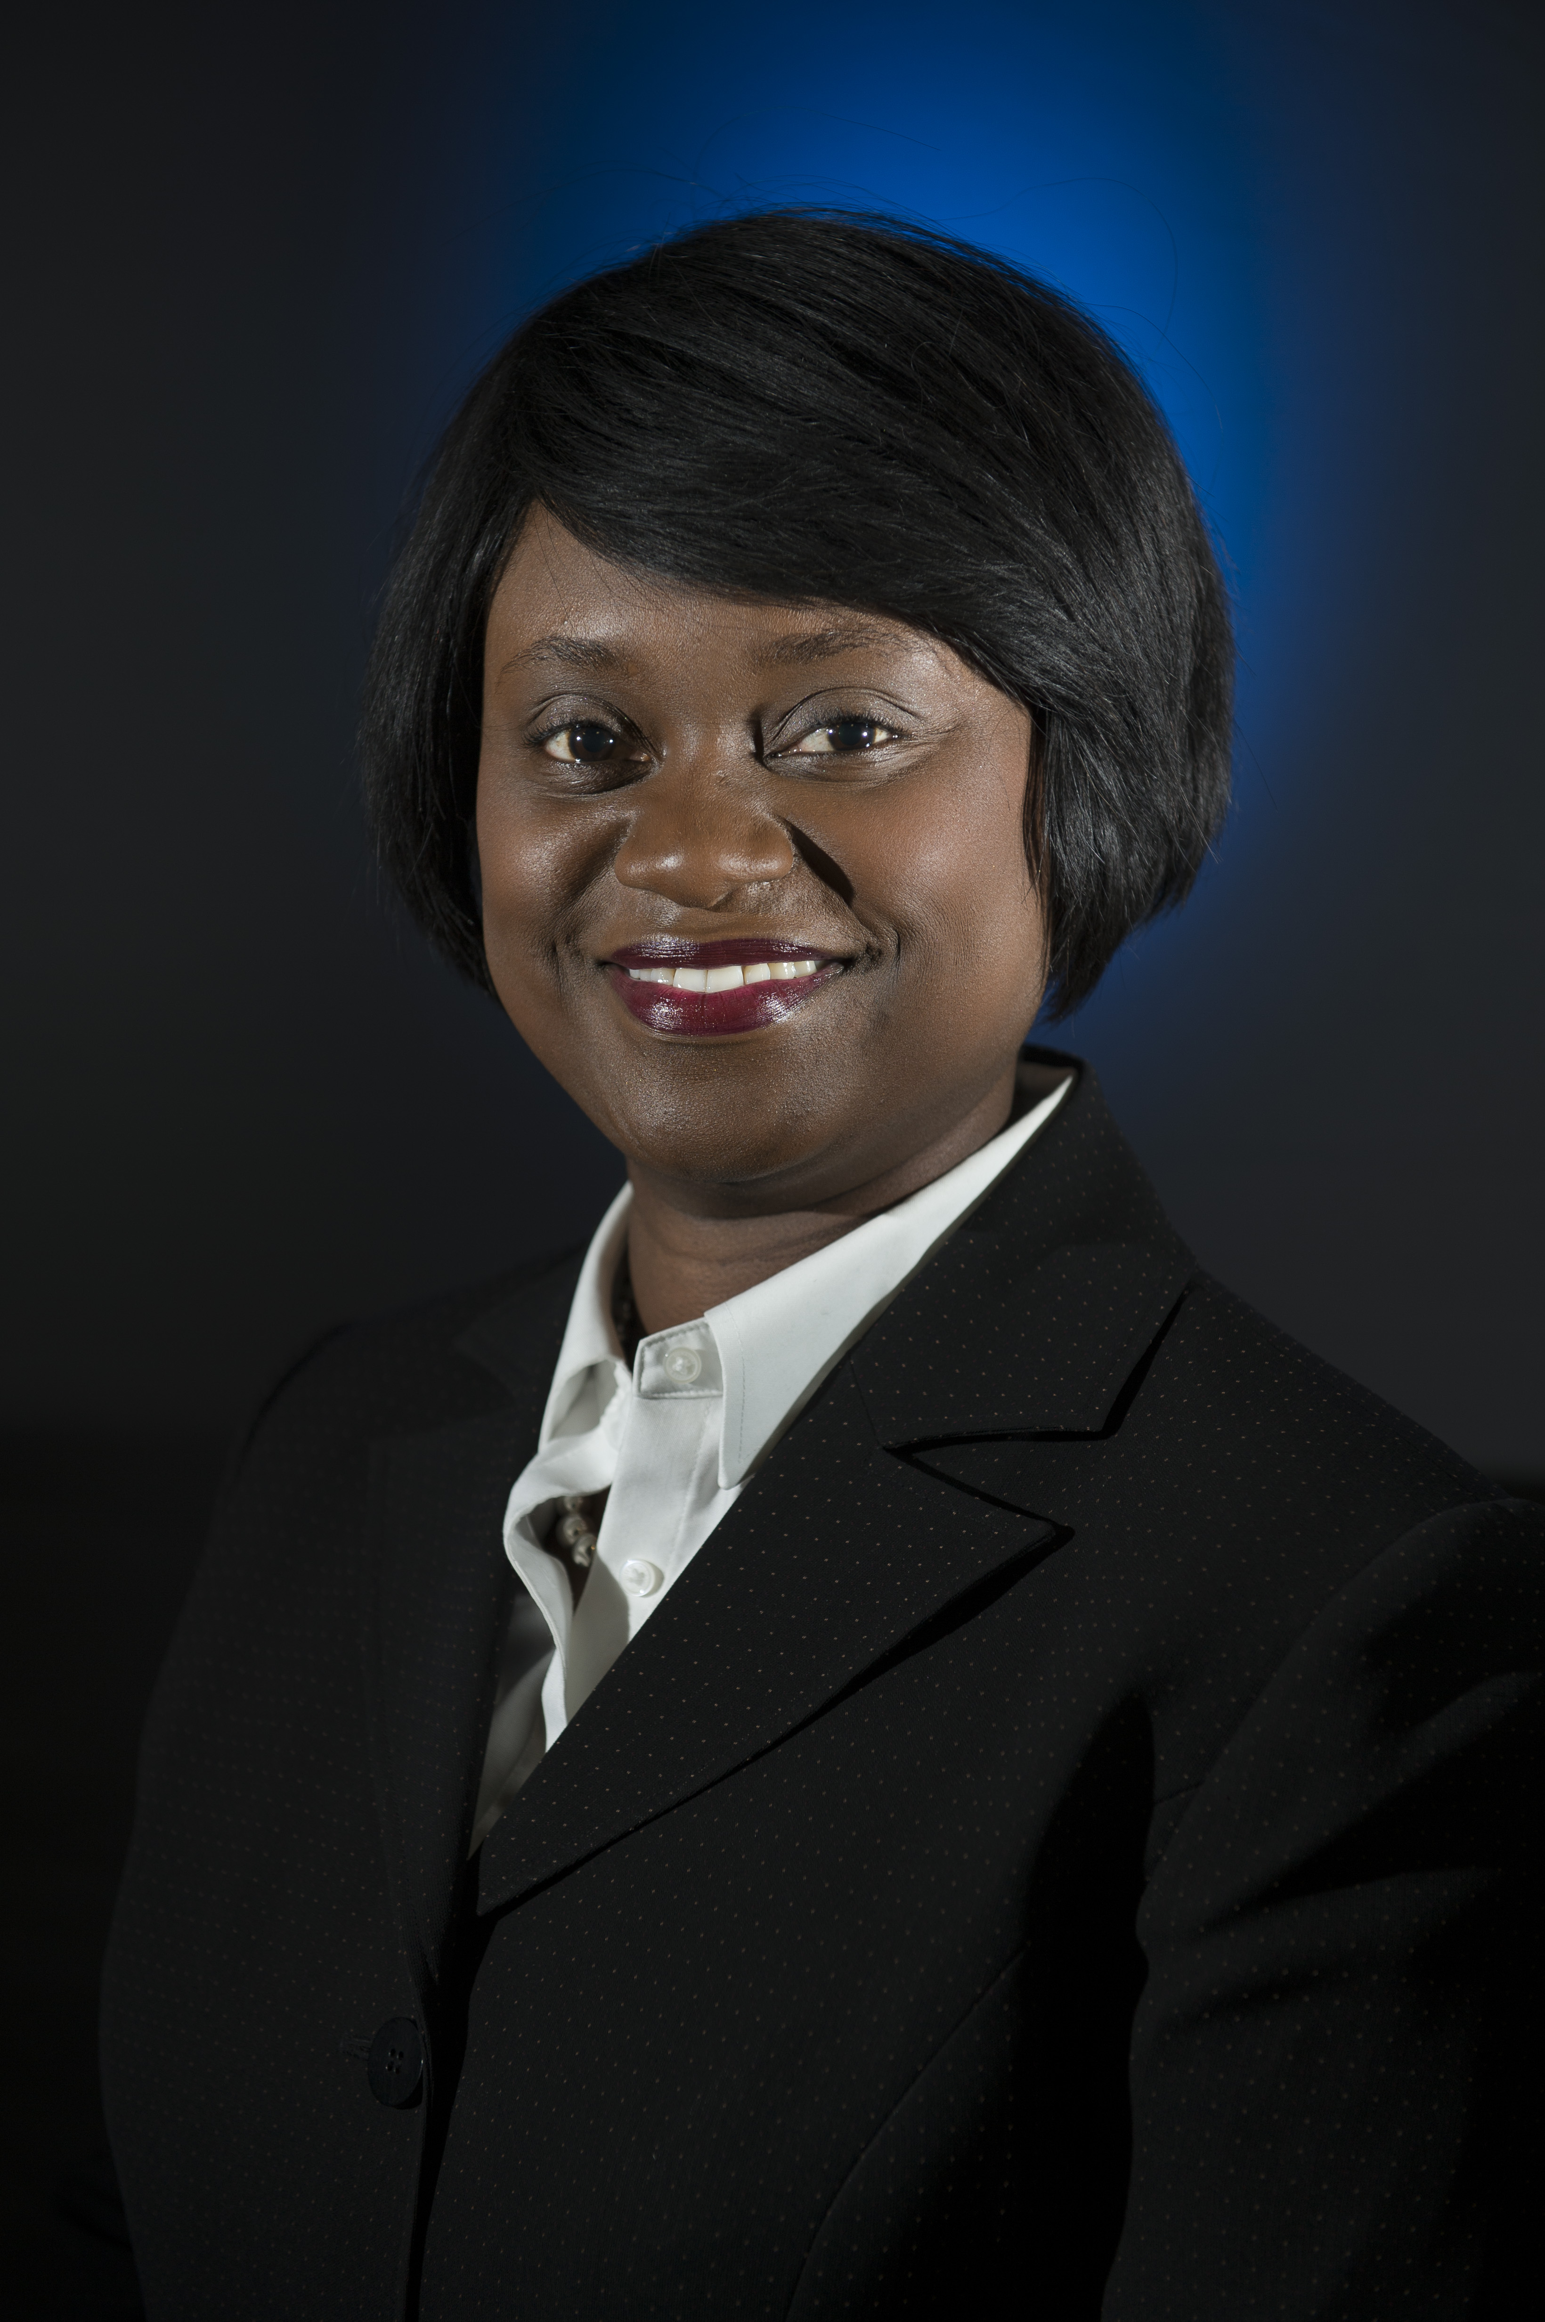
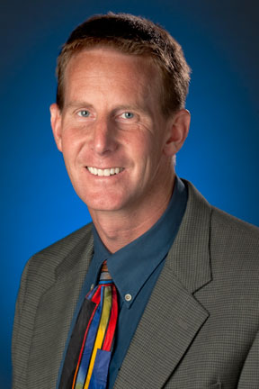
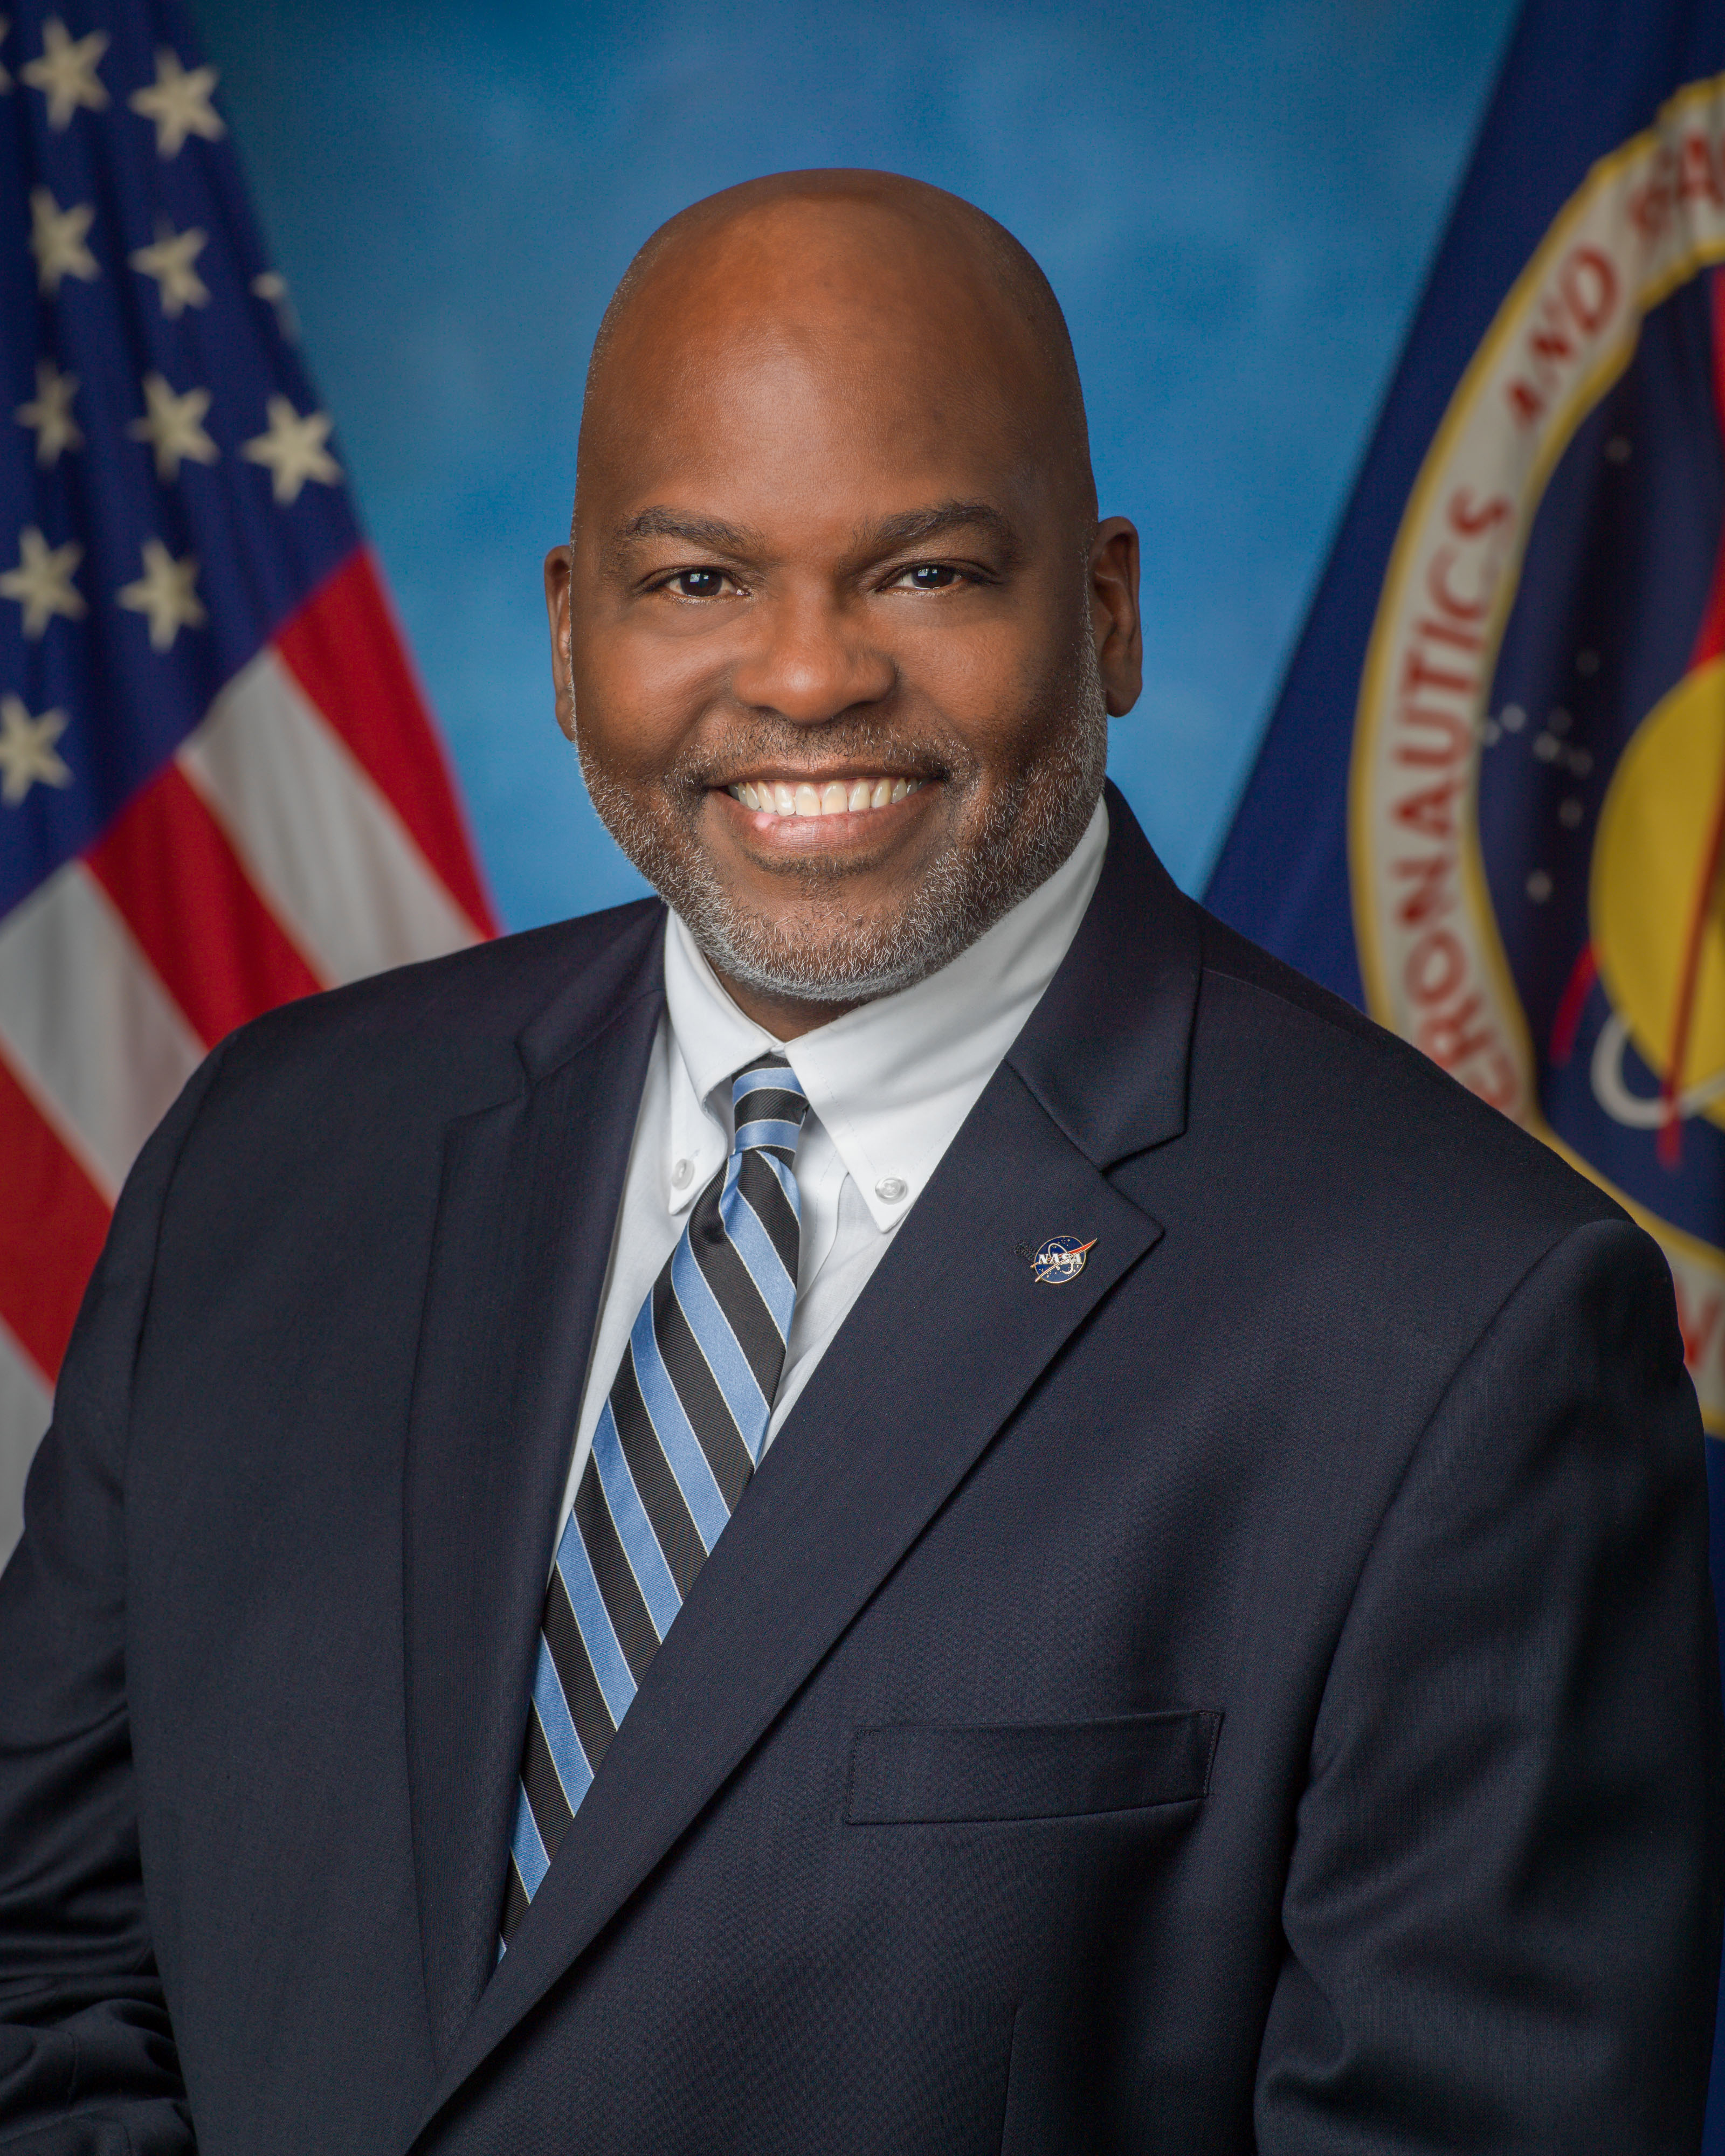
Small Business Learning Series:
Webinar Schedule
Date | Topic | Guest
March 13, 2018 | Leveraging Your HBCU/MI Presence at the Agency Through the NVDB Utilizing Effective Capability Statements | Truphelia M. Parker
March 20, 2018 | Relevance of Subcontracting | Richard L. Mann
April 3, 2018 | Category Management 101: What Small Businesses Need to Know | Stacy Swann, GSA
April 18, 2018 | NASA’s Mentor-Protégé Program | Tabisa Taliwaku Kalisa
May 1, 2018 | Engagement with Tribal Colleges and Universities | Torry Johnson, OE, GSFC
May 15, 2018 | Success Stories of SBIRSTTR Program | Dr. Joseph Grant
June 2018 | Leveraging Your HBCU/MI Presence at the Agency Through the NVDB Utilizing Effective Capability Statement | Truphelia M. Parker
June 2018 | NASA Procurement Update: What Small Businesses Need to Know | Monica Y. Manning
June 2018 | The NASA Science Mission Directorate: What Small Business & Minority Institutions Need to Know when Responding to Solicitations | Ellen Gertsen & Michael New
July 2018 | Utilizing Center Small Business Technical Advisors & Technical Coordinators | Charles T. Williams

Slide 20
Small Business Learning Series: Webinar
Feedback received from attendees on “Demystifying Joint Ventures” webinar (March 6th)…
“Very informative. Updated information on AllSmall MPP and the discussion of SSE is very helpful. Thank you.”
- Lawrence Pokroy
“Fantastic Information, looking forward to receiving the PowerPoint to share with my leadership!”
- Jeffrey C Henley
“This is a very good presentation -- Thank You!!!”
- Walt Sasser
“Thank you, good info.”
- Rudra Prasad
“I thank you all for providing this information”
Shawn Goffer
Link for Learning Sessions
https://www.eventbrite.com/e/nasa-small-business-learning-series-category-management-101-what-small-businesses-need-to-know-tickets-44101250026?aff=erelpanelorg

Slide 21
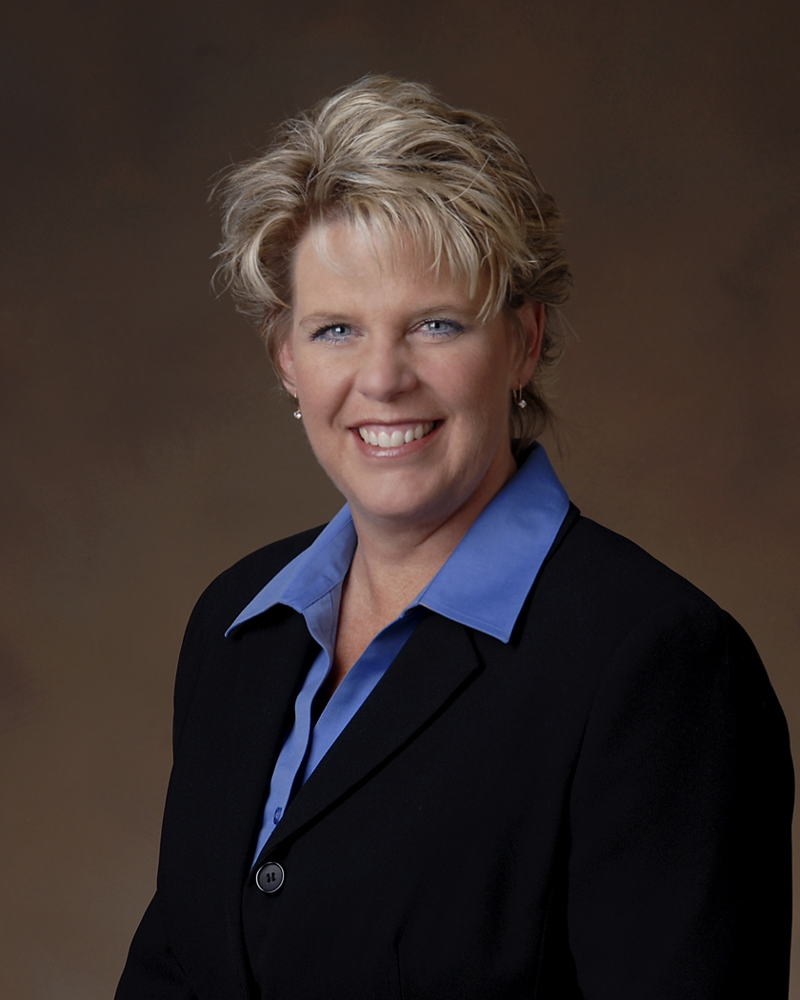
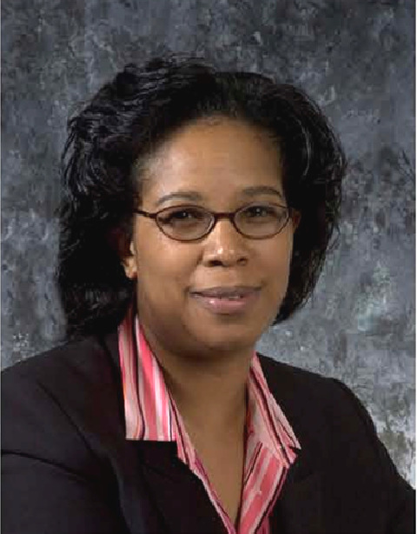

Small Business Learning Series: Podcast
OSBP will produce at least (2) 30-minute audio podcast a month featuring Industries.
Recording Date | Topic | Guest
March 8, 2018 | Be a Triple Threat: Harnessing Data Gathering, Analytical Knowledge and Customer Engagement | Jenifer Scoffield, Orbital ATK
April 2018 | Utilizing your Small Business Advocate within a Large Business | Gwen Johnson - Parsons Government
May 2018 | A HBCUs Perspective on How to become a viable NASA Subcontractor | LaTonya Jones & Sharon Brooks-Hodges

Slide 22
Federal Agencies with
Mentor-Protégé Programs
11 Federal Agencies that currently had Mentor- Protégé Programs only three (3) were approved with Mentor-Protégé Programs to February 20, 2023:
  NASA
  DHS
  DOE
DOD and FAA operate programs that do not fall under the Small Business Act; therefore it did not require a waiver from the SBA
NASA currently has 30 approved mentors
  7 Active Agreements
  10 more agreements in the approval process from 6 different NASA Centers

Slide 23
NASA and SBA
Mentor-Protégé Program (MPP) Comparison

Slide 24
NASA Ames Small Business Office
NASA Office of
Small Business Programs
Ames Research Center
Attn: Christine Munroe
M/S 241-1
Moffett Field, CA 94035
Tel: (650) 604-4695
Fax: (650) 604-0912
E-mail:
ARC-smallbusiness@nasa.gov
Web site:
www.osbp.nasa.gov
https://www.nasa.gov/centers/ames/business/index.html
NASA Vendor Database:
https://vendors.nvdb.nasa.gov

Slide 25


